Slide 1
ECE 532 DATA STRUCTURES AND ALGORITHMS
CHAPTER 1: REVISION OF COMPUTER PROGRAMMING CONCEPT
(POINTERS)
Lecturer: Dr. Roslina Mohamad
Room: Tower 2, Level 13, No:14C
Contact No: 03-55436068

Slide 2

Before We Begin…
Recite Du’a

Slide 3


Class Representative

Slide 4

COURSE OUTLINES

Slide 5
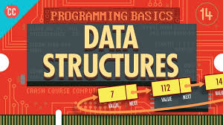
WHY WE NEED TO LEARN DATA STRUCTURES??

Slide 6

BEFORE WE LEARN DATA STRUCTURES IN DETAILS, WE WILL REVISE THESE TOPICS IN CHAPTER 1
POINTERS
ARRAYS
STRUCTURES
FUNCTIONS

Slide 7

At the end of this lecture, you will be able to:
Understand about the pointer data type and pointer variables
Understand how to declare and manipulate pointer variables
Revise about the address of operator and the dereferencing/indirection operator

Slide 8


Slide 9
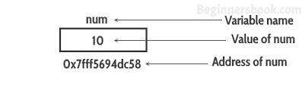
Pointers and the Address Operator
Each variable in a program is stored at a unique location in memory that has an address
Use the address operator & to get the address of a variable:
int num = 10;
cout << &num; // prints address
// in hexadecimal
The address of a memory location is a pointer
//See Example 1.1

Slide 10
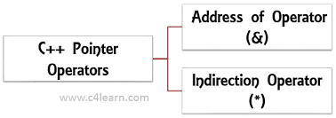
Address of Operator (&)
The ampersand, &, is called the address of operator
The address of operator is a unary operator that returns the address of its operand

Slide 11
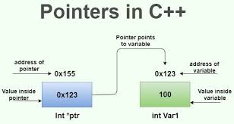
Pointer Variables (*)
Pointer variable (pointer): a variable that holds an address
Pointers provide an alternate way to access memory locations

Slide 12

Declaring Pointer Variables
Syntax:
Examples:
int *p;
char *ch;
These statements are equivalent:
int *p;
int* p;
int * p;

Slide 13


Declaring Pointer Variables
In the statement:
int* p, q;
only p is the pointer variable, not q; here q is an int variable
To avoid confusion, attach the character * to the variable name:
int *p, q;
int *p, *q;

Slide 14
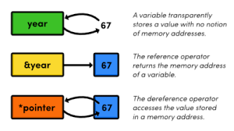
Pointer Variables
Definition:
int *intptr;
Read as:
“intptr can hold the address of an int” or “the variable that intptr points to has type int”
The spacing in the definition does not matter:
int * intptr;
int* intptr;
* is called the indirection operator/ dereferencing operator

Slide 15

Dereferencing Operator (*)
When used as a unary operator, * is the dereferencing operator or indirection operator
Refers to object to which its operand points
Example:
To print the value of x, using p:
To store a value in x, using p:

Slide 16
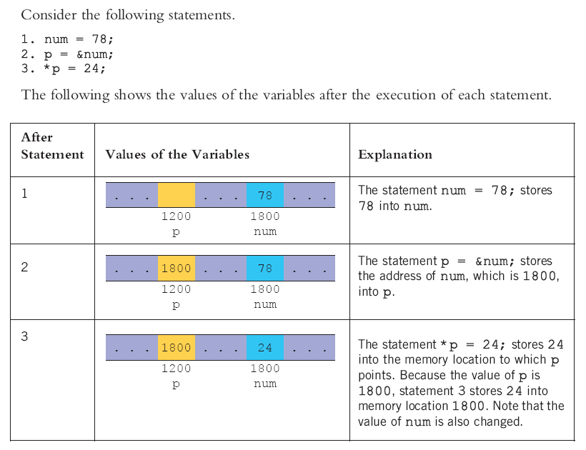
Dereferencing Operator (*)

Slide 17
Initializing Pointers
Can initialize to NULL or 0 (zero)
int *ptr = NULL;
Can initialize to addresses of other variables
int num, *numPtr = &num;
Initial value must have correct type
float cost;
int *ptr = &cost; // won't work

Slide 18
Pointer Variables
Assignment:
int num = 25;
int *intptr;
intptr = &num;
Memory layout:
Can access num using intptr and indirection operator *:
cout << intptr; // prints 0x4a00
cout << *intptr; // prints 25
*intptr = 20; // puts 20 in num
//See
Example 1.2, Example 1.3 ,Example 1.4
num
intptr
25
0x4a00
address of num: 0x4a00

Slide 19
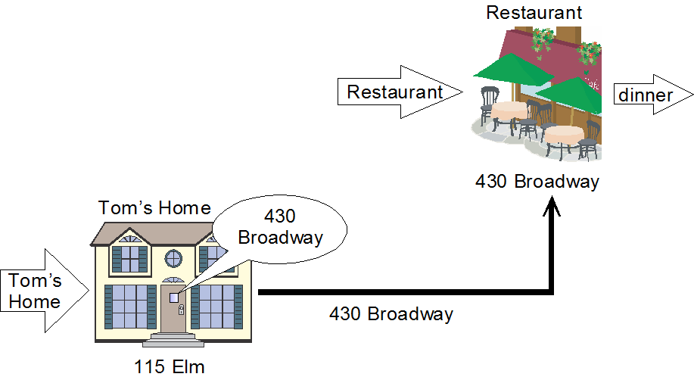
An Example for a pointer application

Slide 20
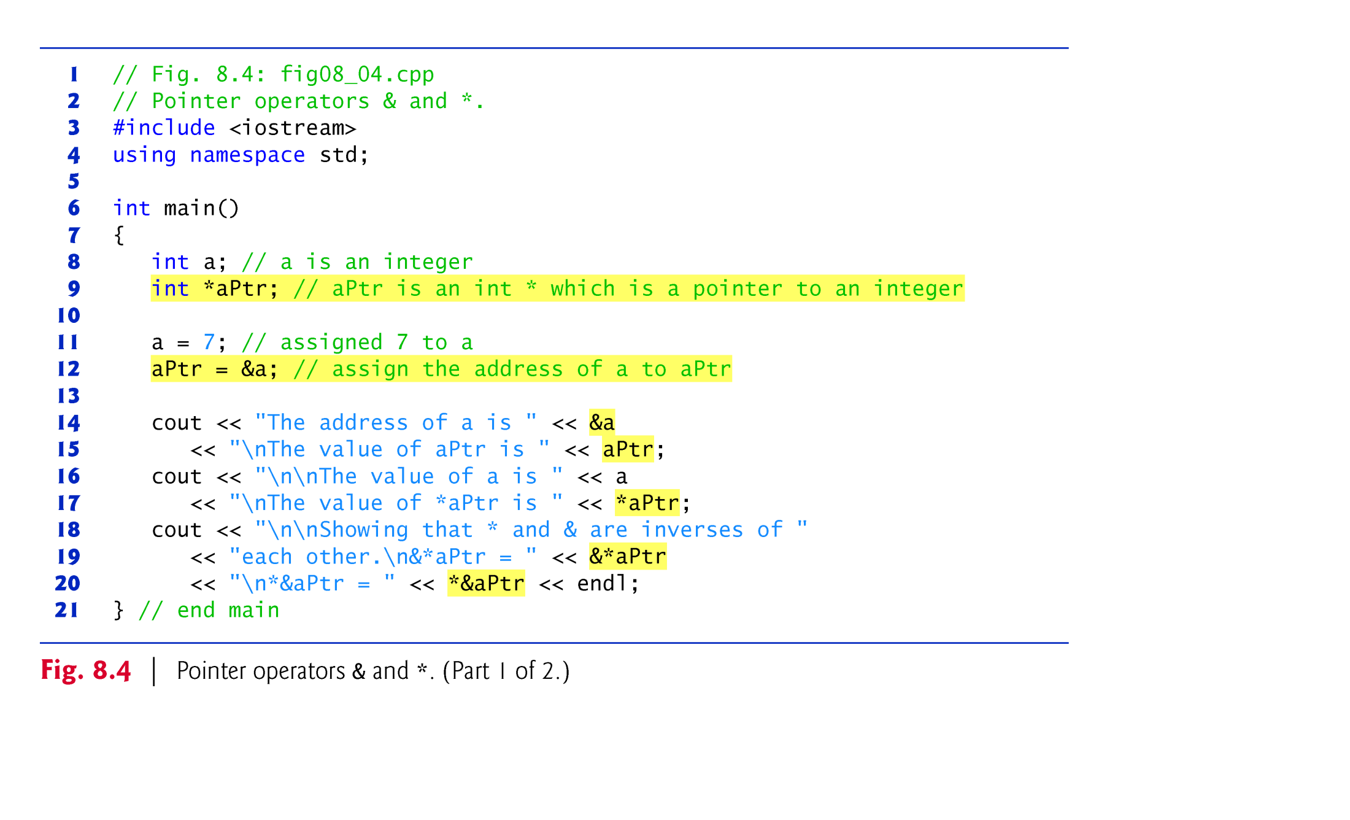

Slide 21
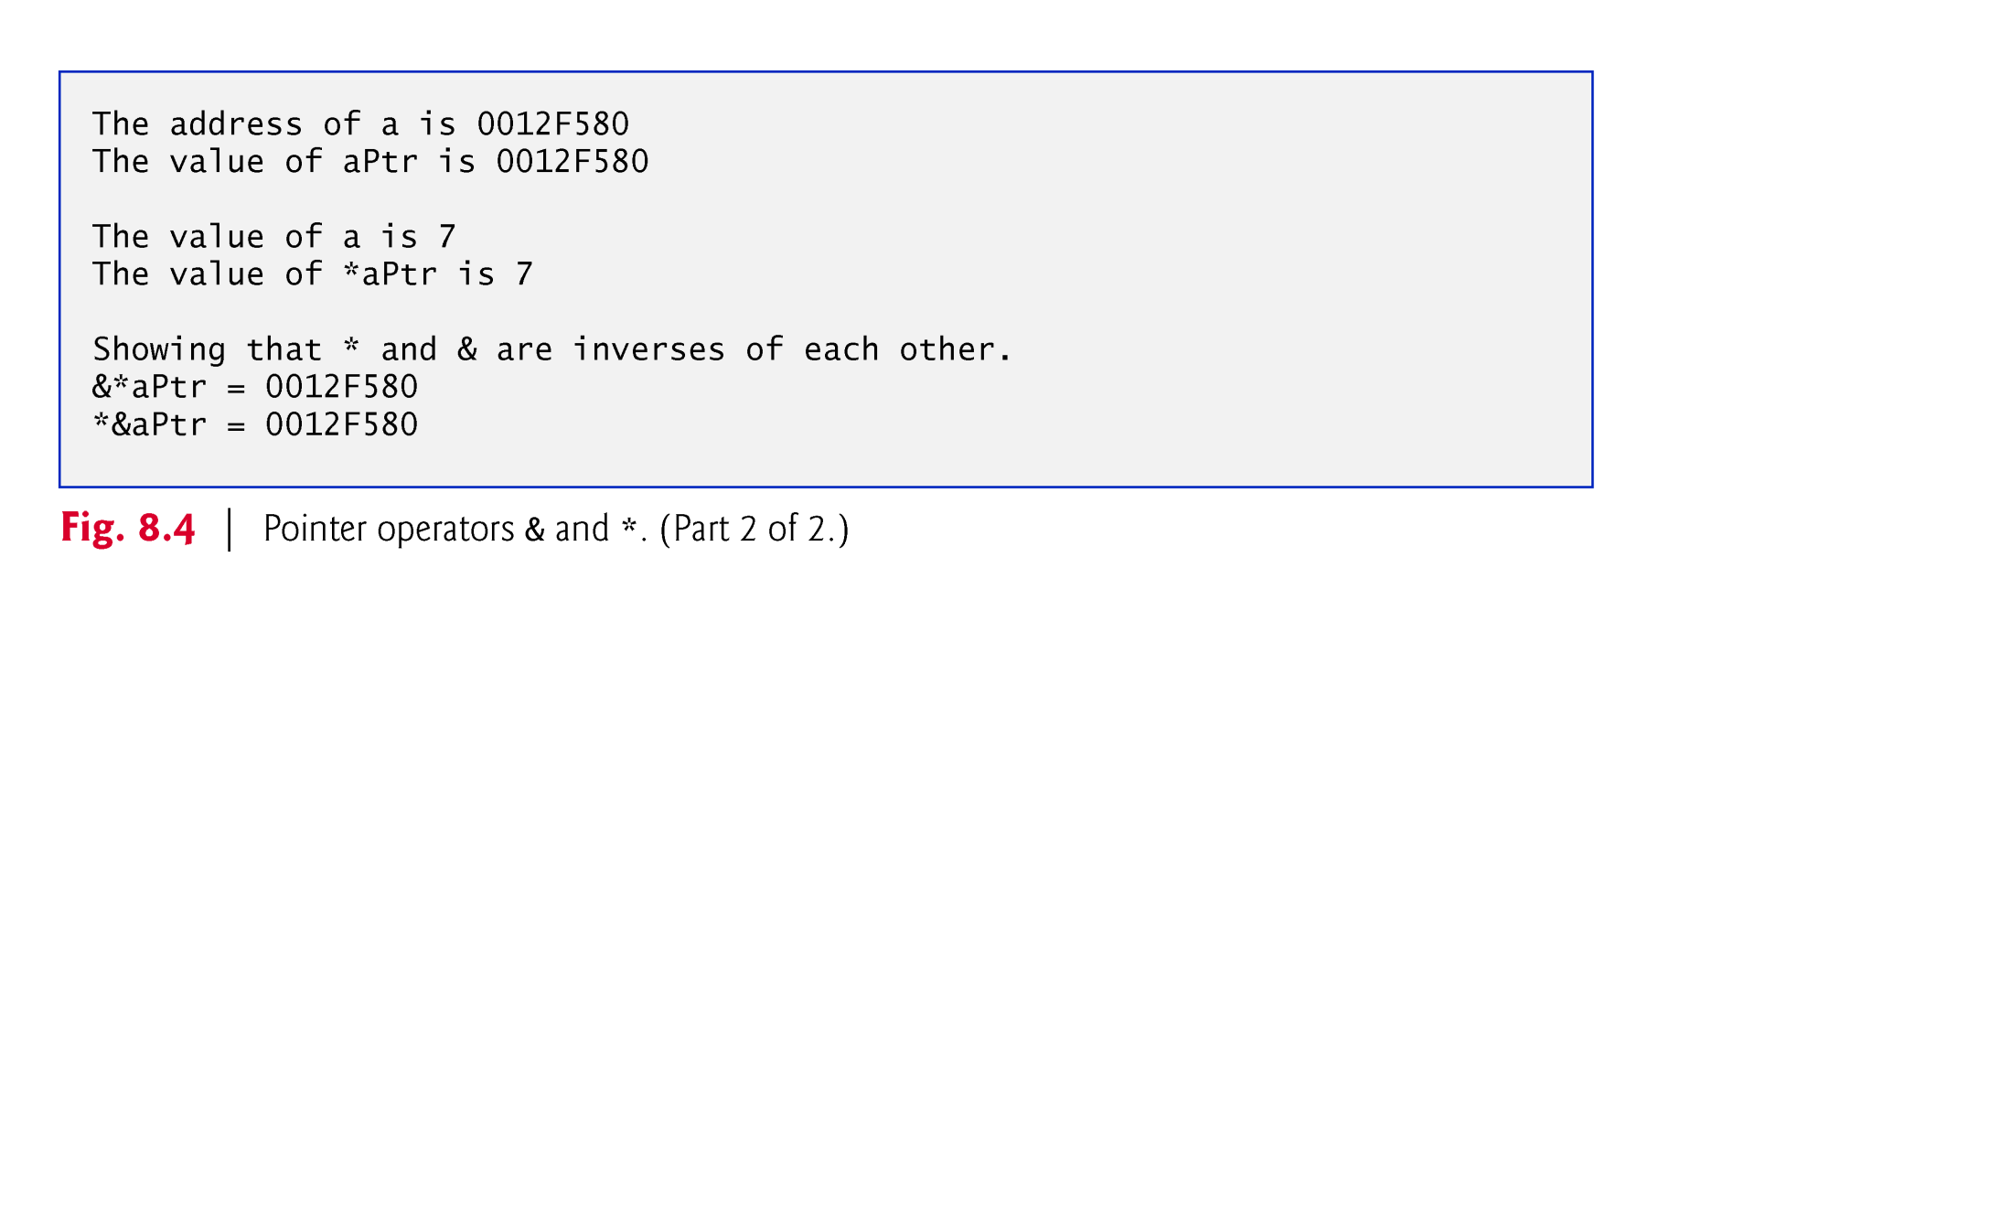

Slide 22
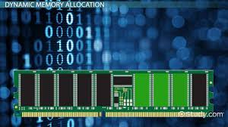
DYNAMIC MEMORY ALLOCATION

Slide 23
Dynamic Memory Allocation
Can allocate storage for a variable while program is running
Uses new operator to allocate memory
double *dptr;
dptr = new double;
new returns address of memory location

Slide 24

Releasing dynamic memory

Slide 25
Releasing Dynamic Memory
Use delete to free dynamic memory
delete count;
Only use delete with dynamic memory!
Notes:
See pr10-14.cpp

Slide 26
Dangling Pointers and Memory Leaks
A pointer is dangling if it contains the address of memory that has been freed by a call to delete.
Solution: set such pointers to 0 as soon as memory is freed.
A memory leak occurs if no-longer-needed dynamic memory is not freed. The memory is unavailable for reuse within the program.
Solution: free up dynamic memory after use

Slide 27
Dynamic Memory Example
int *count;
count = new int;
cout <<"How many students? ";
cin >> *count;
delete count;
count=NULL;
//See Example 1.5

